Slide 1




An Introduction to Traineeships
Notes:
My name is ‘insert name’ and I’m here on behalf of the National Apprenticeship Service, part of the Department for Education, to talk to you about traineeships.
Traineeships have really changed over the last few years
Although some of you may already know what you’re planning to do when you leave school, what we are talking about today is important so that you keep your options open.
And for anyone who hasn’t quite decided what they want to do next when they leave school, I hope today will be really useful in helping you to understand your options.

Slide 2




What is a traineeship?
16 to 24
Notes:
There is a programme called a Traineeship
Traineeships are education and training programmes, run by colleges and training providers, that prepare young people aged 16 to 24 to progress onto an apprenticeship, employment or further learning like a college course
They are made up of three main parts:
English and maths support (if you need it)
Employability skills and
Work experience with a local employer
Traineeships can last anywhere between 6 weeks and 12 months, depending on how the training provider best feels the course can support you
Typically however, they tend to last less than 6 months
The Government have recently announced that they will provide £1,000 to employers for every traineeship they offer, and they will triple the number of places available for young people to be able to start a traineeship, hopefully providing more opportunities for you

Slide 3


What support will you get from the
Training Provider or College?
Training to prepare you for work
Help with applying for jobs
Support to prepare your CV
Support to improve your English and maths
Notes:
You will be supported throughout your traineeship by a Training Provider/College
They will give you:
- Training to prepare you for work including CV writing and what to expect in the workplace
- Support to improve your English and maths if you need it
- They will also help you to organise your work experience placement with an employer
They will spend time with you to work out what you are interested in and the type of employer that might suit you best, and will then help to set this up
- The provider and employer will come up with a joint plan for how they can best support you through the traineeship, which will then help to determine the length of your traineeship
- There are a wide variety of companies and organisations that provide Traineeships
Some will be really well known names from the high street, and other businesses might be organisations and charities that you haven’t heard of before

Slide 4



What support will you get from the Company?
Work placement
Interview
Tailored to you
Supported by the employer
Notes:
When your placement begins with the employer, they will also support you
They will ensure that you receive:
A high-quality work placement of at least 70 hours
An interview for an apprenticeship or job if available, or an exit interview with written feedback
The programmes can be tailored to meet your needs or those of the business and local labour market
Giving you quality work experience on site learning about that industry and job role

Slide 5
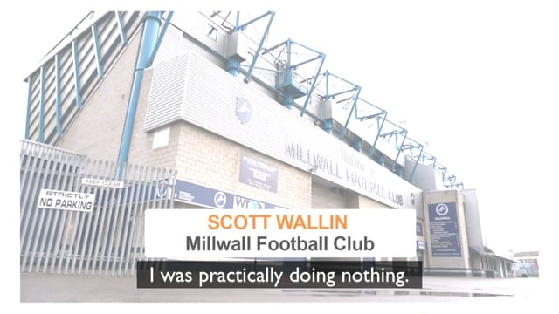
What are the benefits of doing a traineeship?
Notes:
Traineeships provide the opportunity for you to build your CV with local and national employers.
This allows you to learn about the business and the industry, which is really valuable to show your future employer.
See how Scott has progressed, after only four weeks, with his traineeship at Millwall Football Club
Presenter notes
Ensure that the film is working. This can be downloaded and embedded from https://vimeo.com/222357782

Slide 6



You may get extra support
Expenses for travel
Financial support
Support from JCP
Notes:
As Scott mentioned before, a traineeship is provided to young people for free
Employers are not required to pay you for taking part in a traineeship, however, some may support you with expenses such as transport and meals
Depending upon your circumstances, you maybe eligible for further financial support through your training provider, such as support for travel, childcare costs or if any extra support is required due to a disability
You may also receive support from your local Jobcentre Plus if you are eligible for work benefits

Slide 7
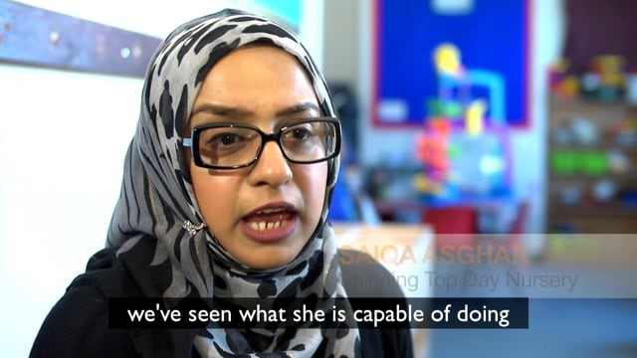

What happens at the end of my traineeship?
Notes:
At the end of your Traineeship programme, each young person is guaranteed a job interview. This doesn’t necessarily mean that the employer has a vacancy, but they will practice what it is like to have an interview with you.
See how Rukhsar used her traineeship to progress onto an apprenticeship
Presenter notes
Ensure that the film is working. This can be downloaded and embedded from https://vimeo.com/221742256

Slide 8















What kind of traineeships are there?
Finance
Sport & Fitness
Horticulture
Health Care
Media
Business
Admin
Retail
Warehousing
Electrician
Hairdressing
Painting
Customer Service
Catering
Hospitality
IT
And many more….
Notes:
There are a wide variety of traineeships available, with programmes available in numerous sectors and industries
With sport, media, finance, business admin, health, hairdressing, catering, IT, and many more, doing a traineeship could find you gaining valuable work experience in a sector that interests you. You will learn hands on and contribute to the team whilst learning about the role involved

Slide 9

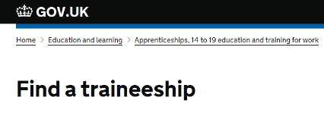
What do I do next?
www.gov.uk/find-traineeship
Notes:
If you are a young person who is:
not currently in full-time employment
has little work experience;
are aged 16 to 24 and
qualified up to Level 3 (A levels or equivalent)
and could be ‘work ready’ within 6 months
then a traineeship could be for you!
There are a few different ways that you can look for a traineeship
There is a website that you can use called Find a traineeship
Visit https://www.gov.uk/find-traineeship and enter in your location and interests to see what is available near you

Slide 10



Where else can I look for a traineeship?
Ask your local
college or
training provider
Speak to your school or college
Careers Adviser
Notes:
However, not all traineeships are listed on this site and so it is important that you look elsewhere also
There are lots of other places that you could look to find a traineeship:
Ask your local college or training provider
Speaking to your school careers advisers if you’re 16 to 18 years old
Speak to your Jobcentre Plus adviser if you’re in receipt of benefits
Get in touch with the National Careers Service
There is also more information available at https://www.gov.uk/traineeships
Presenter notes
Please find out from your local training provider network which local providers offer traineeships and replace this slide with useful local information if you can.

Slide 11


Intermediate level apprenticeships
Notes:
Once you have completed a traineeship, you may then be ready to move onto an apprenticeship.
Intermediate level apprenticeships (level 2) are equivalent to five good GCSE passes
They are a great way to take the first step in starting your future career
As an intermediate apprentice, you will be paid a salary whilst studying towards qualifications and also gaining valuable workplace experience
Entry requirements for intermediate apprenticeships vary, with some employers asking for two or more GCSEs, although you may not need any formal qualifications.
If you don’t have GCSEs in English and maths, you are usually required to take qualifications in these subjects as part of the apprenticeship through a programme called Functional Skills

Slide 12



Contact us
Follow the National Apprenticeship Service:
@fireitupapps
@Apprenticeships
Fireitupapps
National Apprenticeship Service
Search for apprenticeships on GOV.UK or call 0800 015 0400
Notes:
We hope that this session has been useful for you today
There is lots of support out there to help to guide you into the right choice for you
You can contact the National Apprenticeship Service helpline or follow their social media
Remember you can also contact the National Careers Service
Presenter notes:
Face to face - Hand out any appropriate collateral or close session

Slide 13
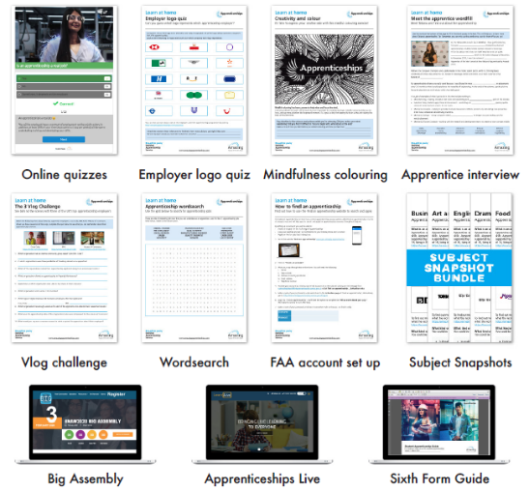
Amazing Apprenticeships
www.amazingapprenticeships.com
Notes:
If you would like to continue learning about traineeships or other vocational pathways such as apprenticeships, there are some brilliant resources available on the Amazing Apprenticeships website.
Go to www.amazingapprenticeships.com
The web address is showing on the screen now so please make a note of it

Slide 14
What are the benefits of doing a traineeship?
Notes:
Traineeships provide the opportunity for you to build your CV with local and national employers.
This allows you to learn about the business and the industry, which is really valuable to show your future employer.
See how Scott has progressed, after only four weeks, with his traineeship at Millwall Football Club
Presenter notes
Ensure that the film is working. This can be downloaded and embedded from https://vimeo.com/222357782

Slide 15
What happens at the end of my traineeship?
Notes:
At the end of your Traineeship programme, each young person is guaranteed a job interview. This doesn’t necessarily mean that the employer has a vacancy, but they will practice what it is like to have an interview with you.
See how Rukhsar used her traineeship to progress onto an apprenticeship
Presenter notes
Ensure that the film is working. This can be downloaded and embedded from https://vimeo.com/221742256

